Slide 1
FuelMart & Subway Safety Committee Meeting
Wednesday, August 21, 2019
2:00 PM
Corporate Office Conference Room and GoTo Meeting Web Conference

Slide 2
June 2019 Review:
Safety Topic – Road Rage
No open safety concerns or suggestions

Slide 3
Incidents and Injuries From 07/16/2019 to 08/20/2019

Slide 4
Employee Injuries:
Previous Injury - 06/24/2019 – Subway employee putting bread on a rack and burnt arm on pan.
Note: This is the third burn injury in 2019 from Subway bread pans.
Reminder: Do not hesitate to contact the Safety Director, Phillip L. or Payroll, Pat C. to ensure an employee personal medical issue while on duty is not considered an employee work-related injury under Federal or your State laws.

Slide 5
FM 782 Customer Incident:
On 07/17/2019 customer indicated she tripped while stepping up on FM store curb to enter the store.

Slide 6
FM 641 Diesel Spill:
On 07/17/2019 a regular semi customer put pump nozzle 23 (premium diesel) on the ground without realizing the trigger was pushed in and locked. The driver went to the satellite side of pump 23 and started pumping fuel without realizing pump 23 nozzle was spraying diesel on the ground. $73.00 of diesel was pumped onto the ground and into the semi saddle tank before the pumps were shut down. Two bays were impacted along with the oil water separator drains at the diesel island. No environmental impact. Non-EPA reportable spill. FM indicated they needed assistance in the cleanup, so Phllip L. drove up to provide assistance and to provide FM with replacement cleanup supplies. FM employees were a great help with the initial containment. There was very little impact to the oil dry due to the amount put down so we will be able to reuse all of the oil dry. Some of the oil dry came back with me and will be re-used at the Wooster garage.

Slide 7
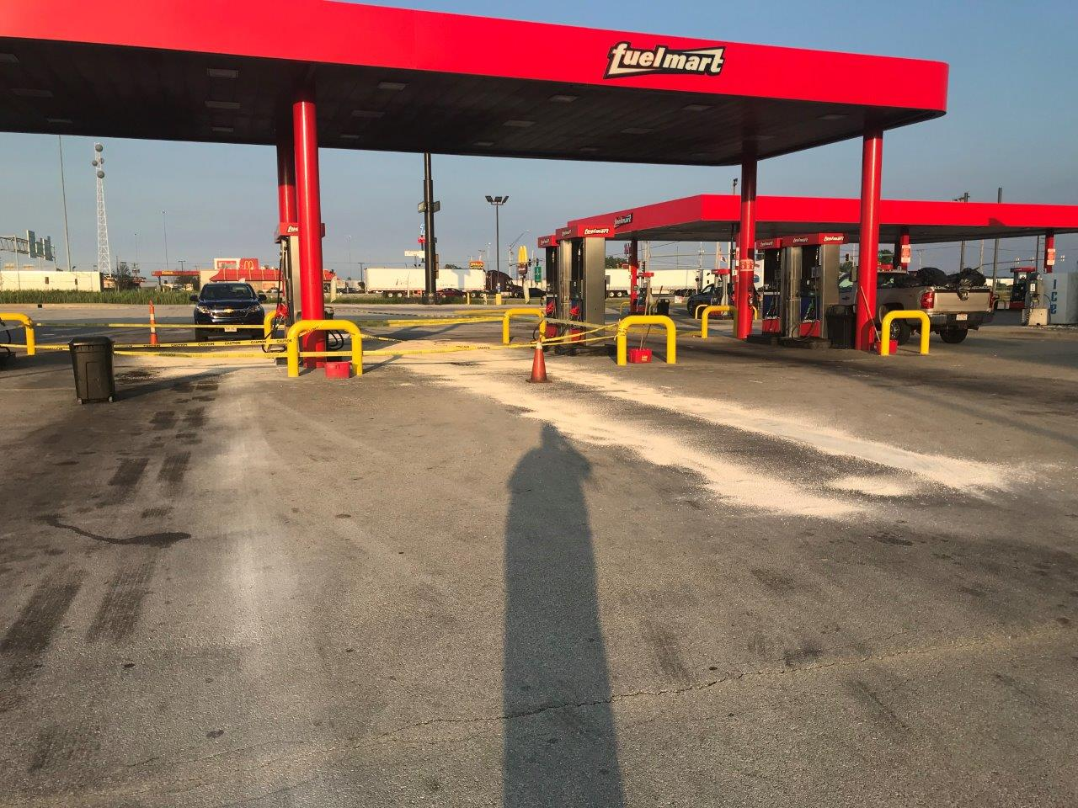
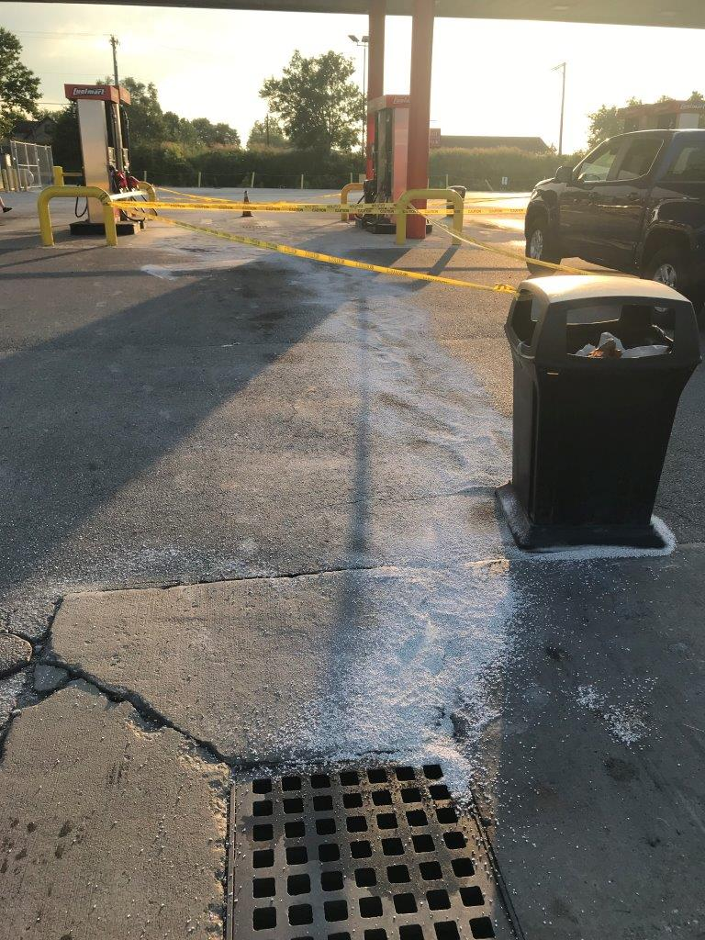
FM 641 Diesel Spill:

Slide 8
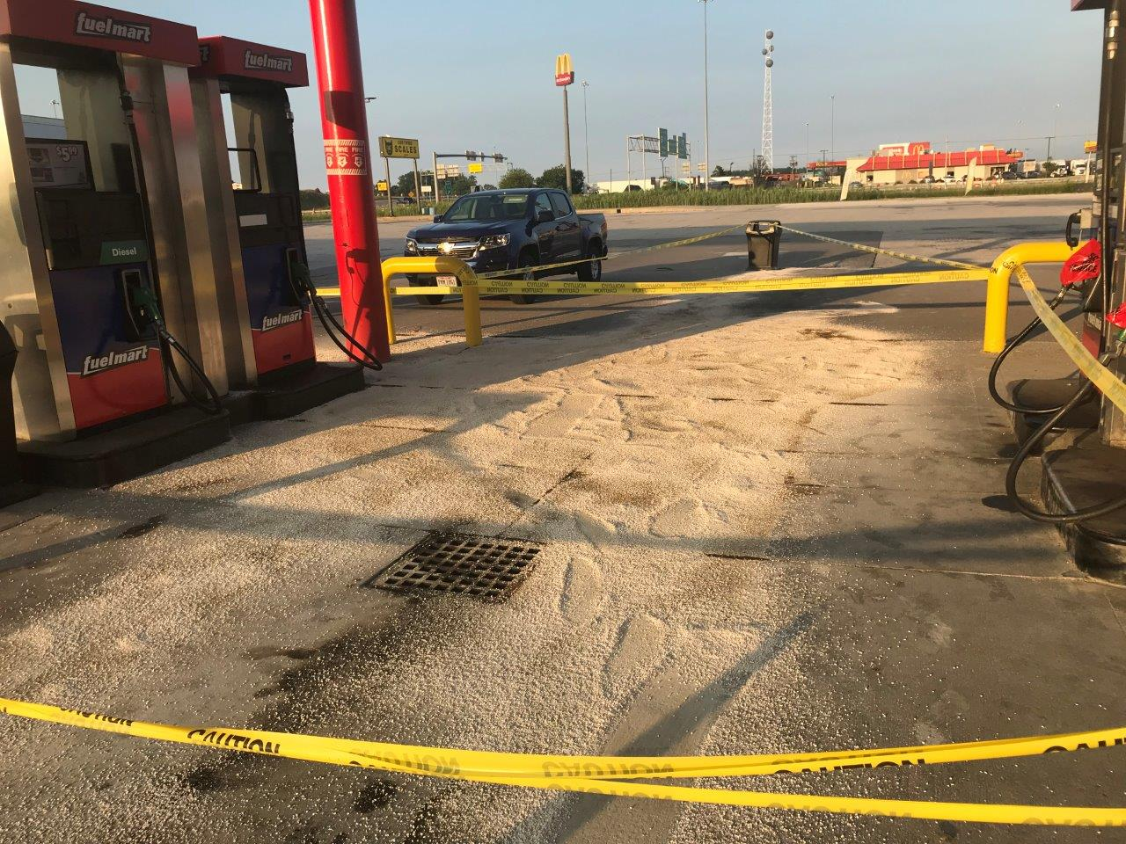
FM 641 Diesel Spill:

Slide 9
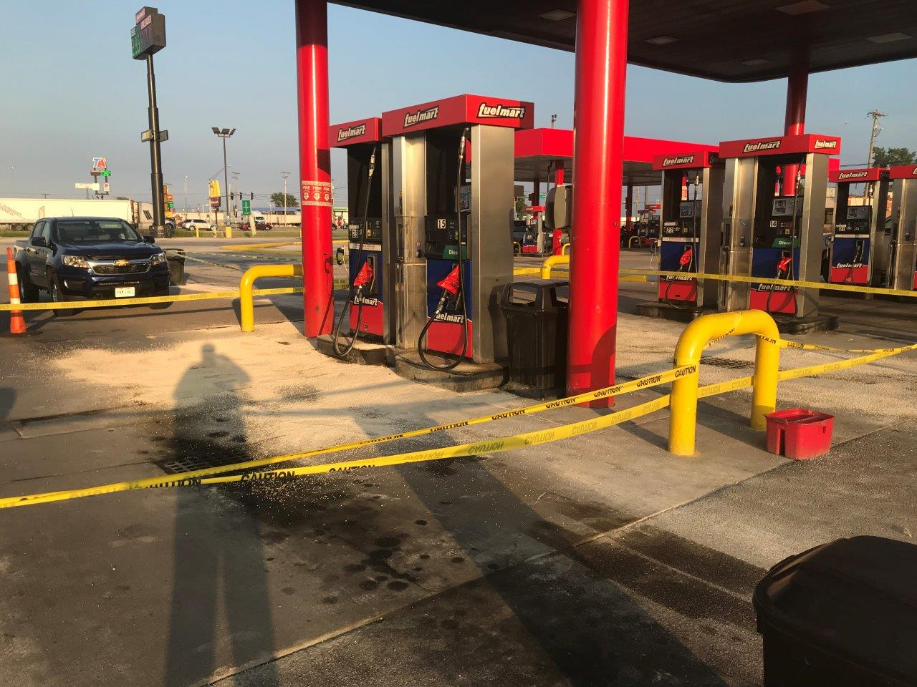
FM 641 Diesel Spill:

Slide 10
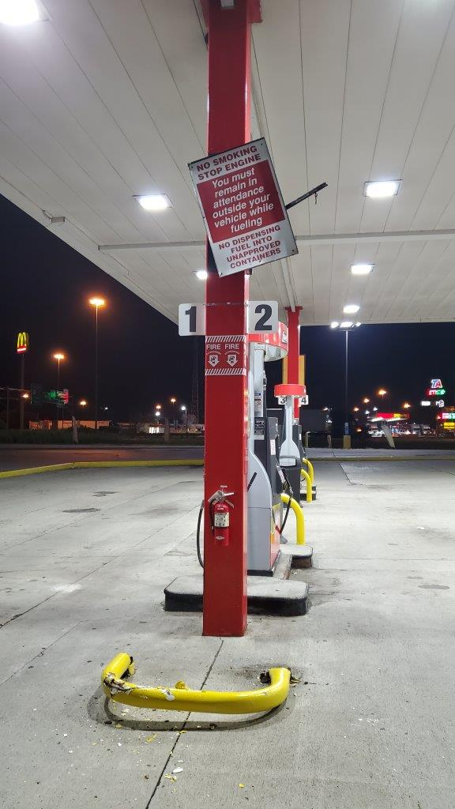
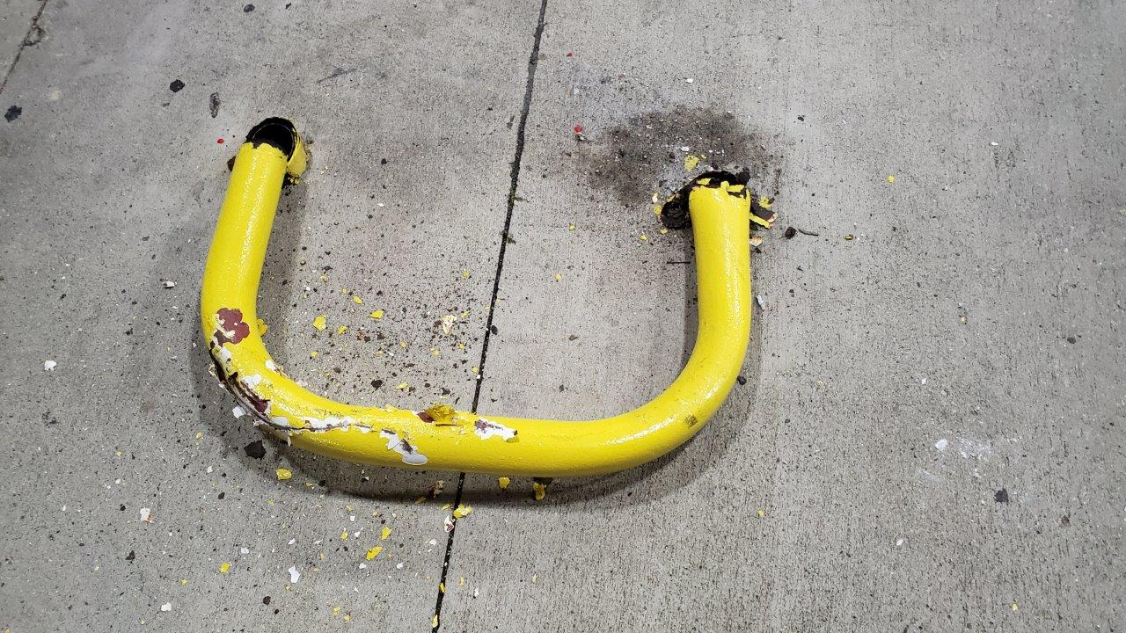
FM 641 property damage:
On 07/19/2019 a driver in a semi-trailer pulled through the gas pumps to turn around and broke a u-shaped metal bollard.

Slide 11
FM 764 Customer Incident:
On 07/25/2019 a customer was leaving FuelMart and stepped on the corner of a rug and it appears the rug moved, and the customer fell.

Slide 12
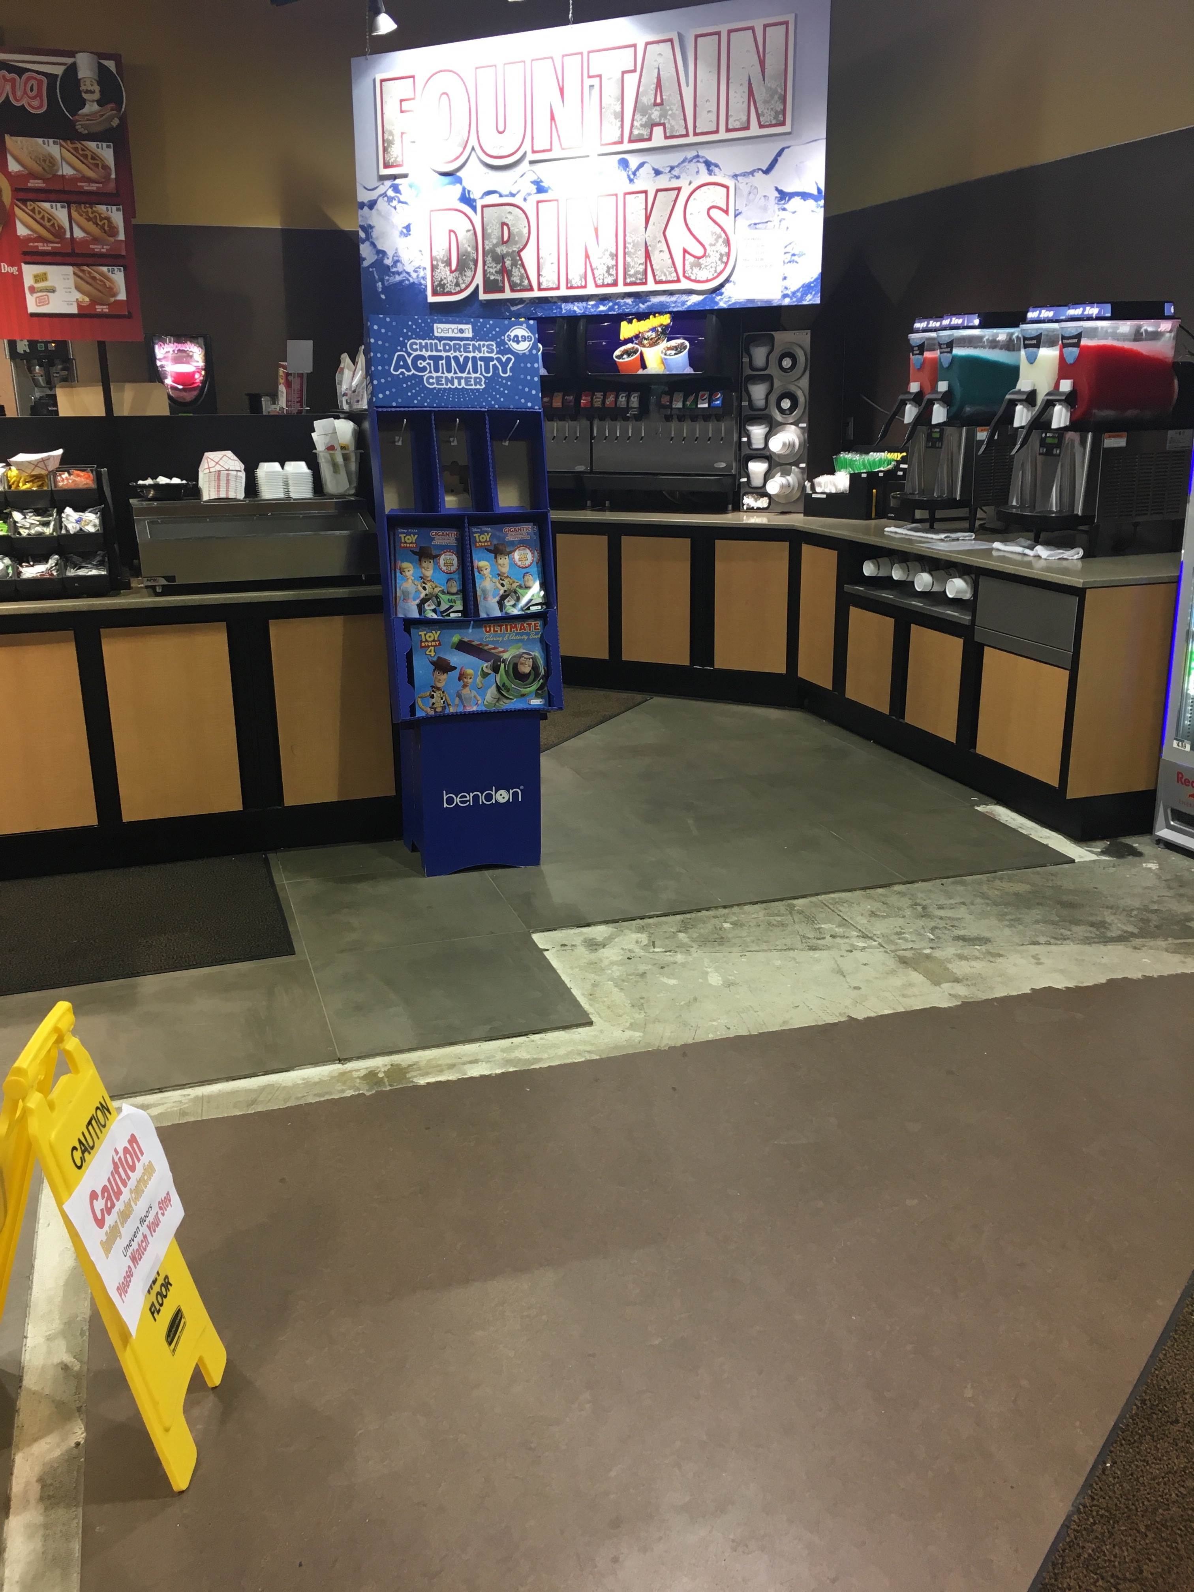
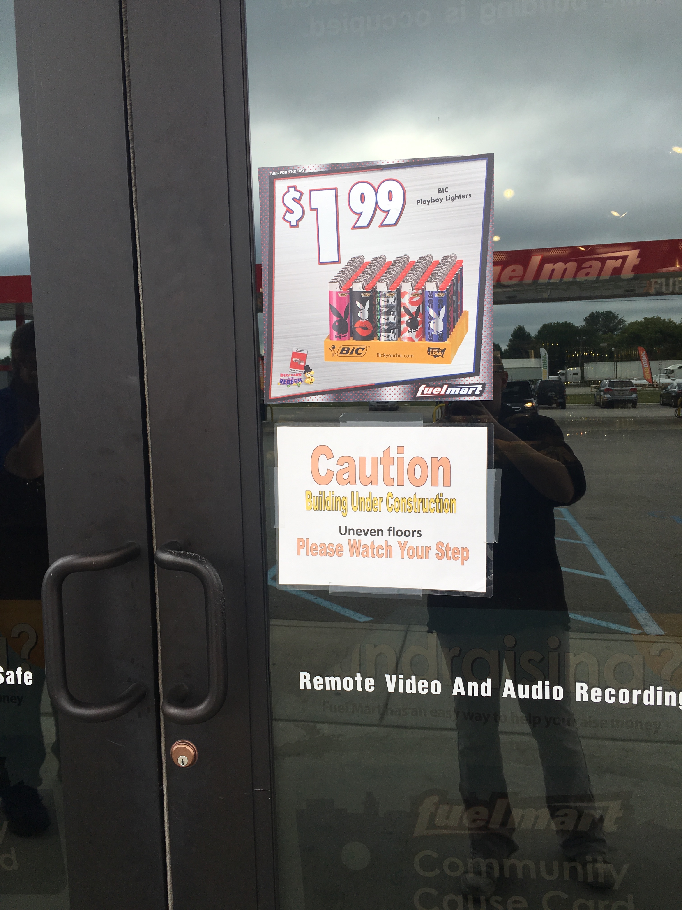
FM 767 Customer Incident:
On 07/31/2019 a customer walking in the coffee area fell in an area where floor tile is being laid. All entrance doors and the construction area had safety warnings posted indicating uneven floor surfaces.

Slide 13
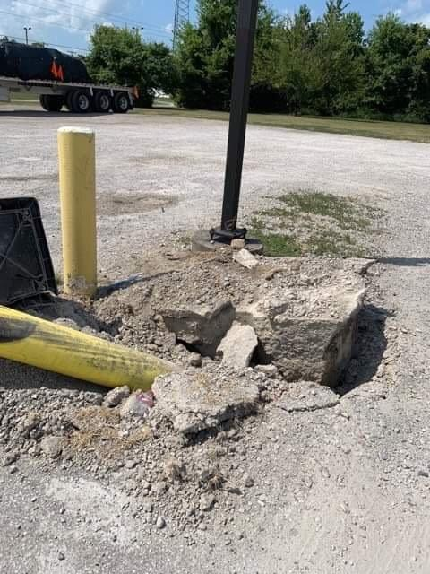
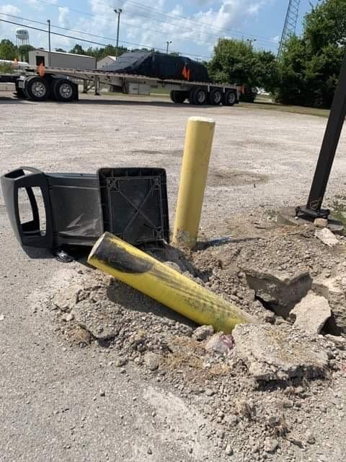
FM 783 property damage:
On 08/09/2019 a CDL driver ran over the bollard and trash can and left the scene. The bollard came out of the ground. A witness notified FM employees of the bollard damage. Goodin's Wrecker Services received a call from a driver asking them to fix/repair a semi. Goodins and the owner of the trucking company have a prior working relationship so Goodin's contacted the owner. The owner investigated and it was determined the damage to his semi occurred at our FM. Goodins contacted FM to let them know they are towing the semi that caused the FM property damage. I made contact with the owner of the trucking company and he was very upset with his CDL employee for leaving the scene and not reporting the damages to FM. The owner apologized.

Slide 14
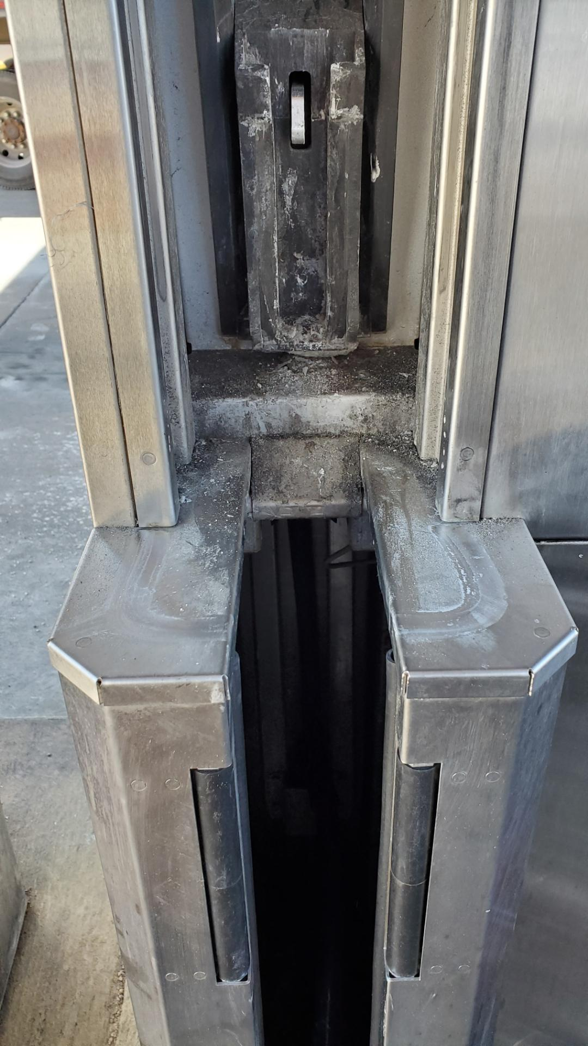
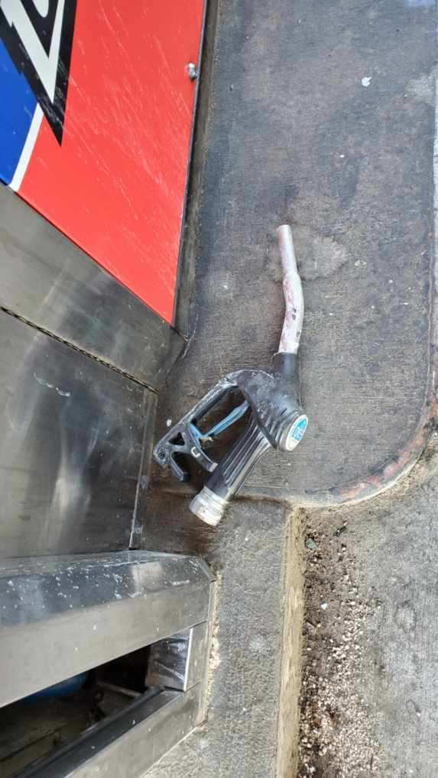
FM 641 DEF Spill:
On 08/10/2019 a DEF hose disconnected at pump 15 after excessive use. The customer indicated the DEF was not pumping properly. When a FM employee went to check the pump, they had to hang it up to turn on the fuel again. The DEF handle was no longer attached to the hose. The customer said “it just fell off.”

Slide 15
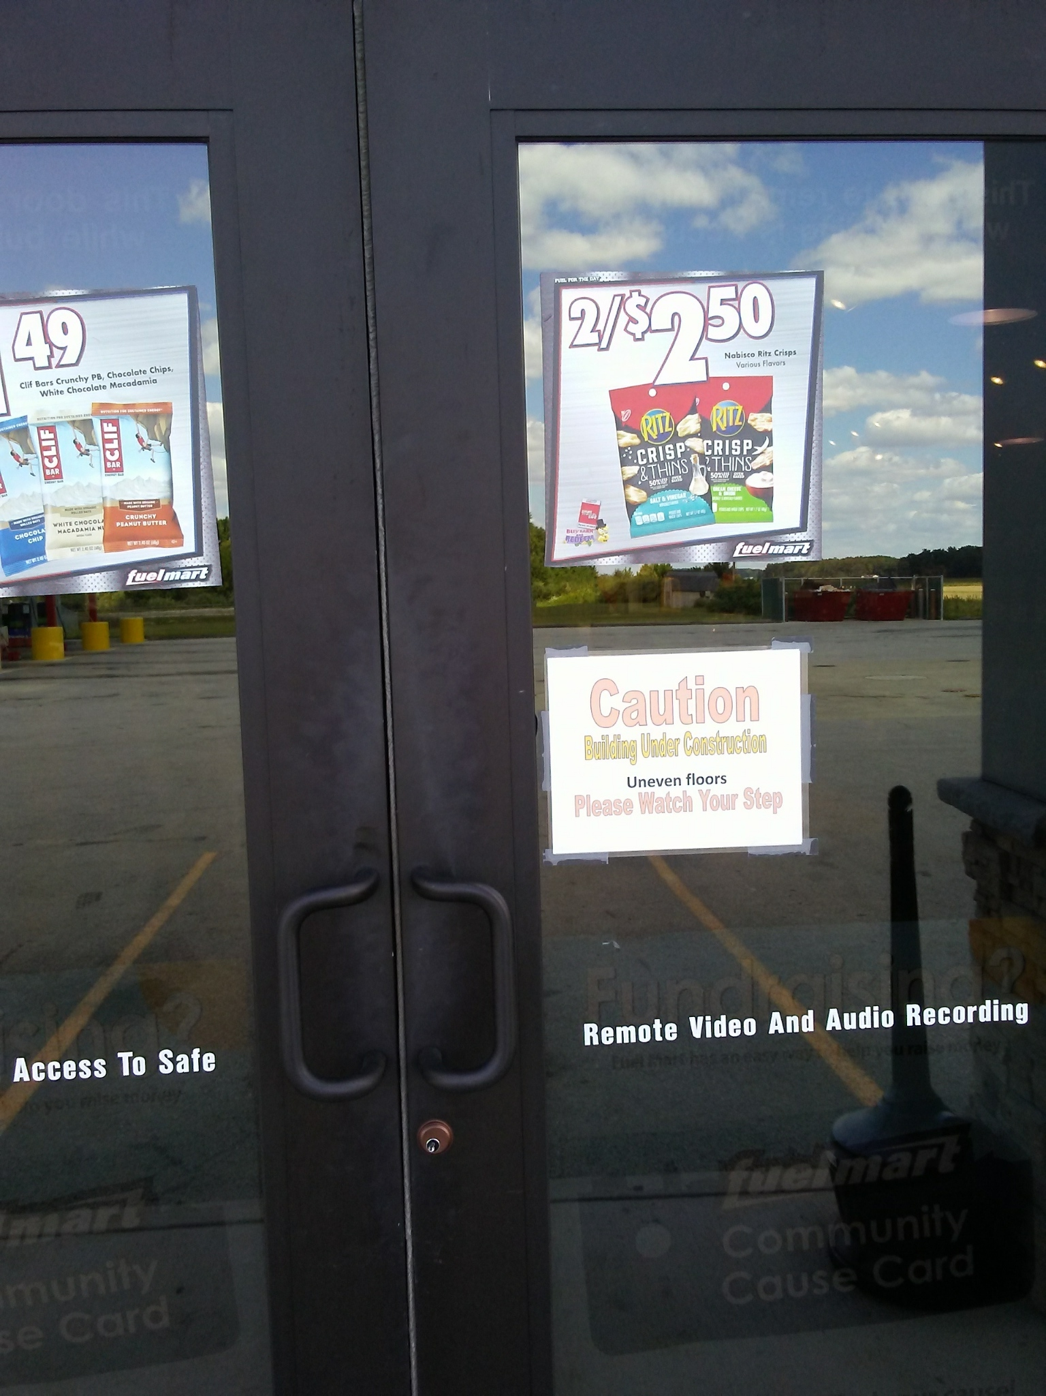
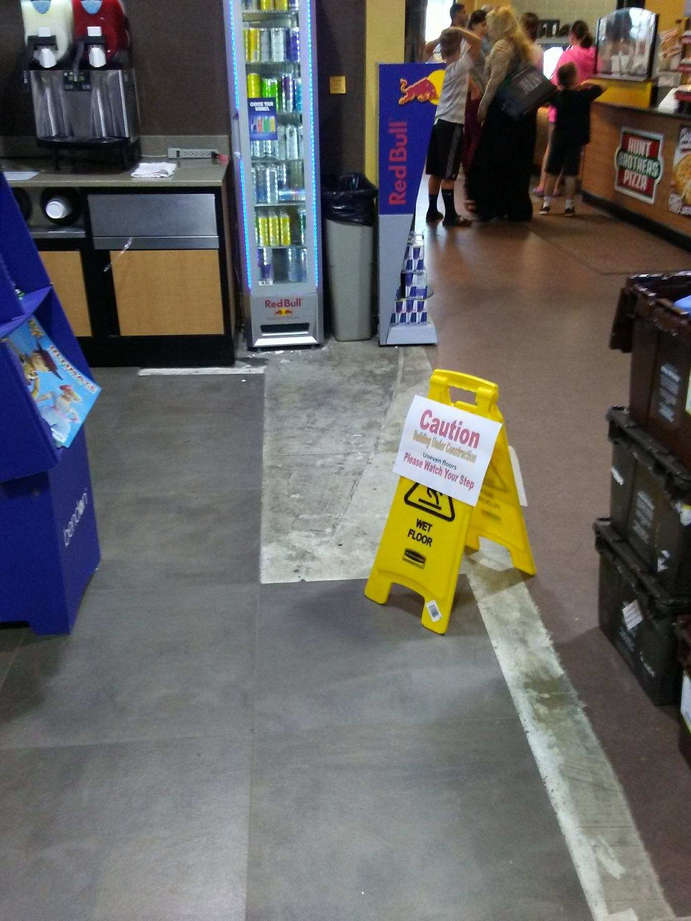
FM 767 Customer Incident:
On 08/10/2019 a customer walking in the fountain drink area fell in an area where floor tile is being laid. All entrance doors and the construction area had safety warnings posted indicating uneven floor surfaces.

Slide 16
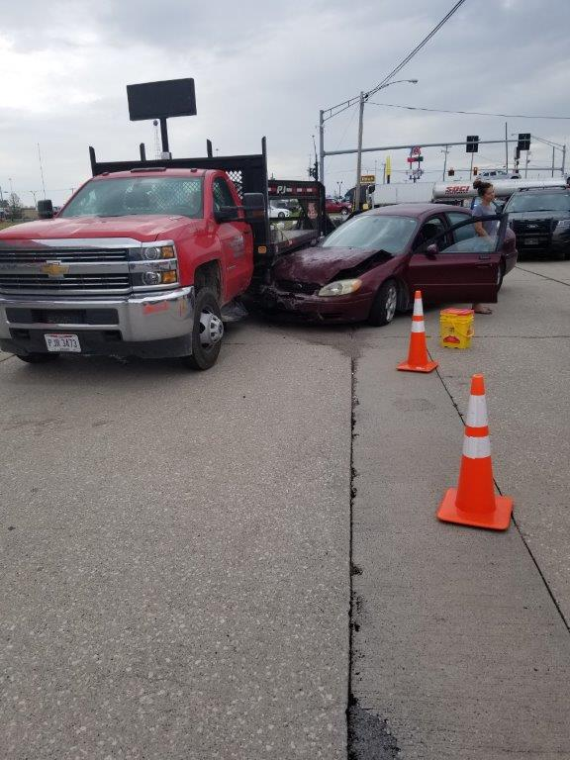
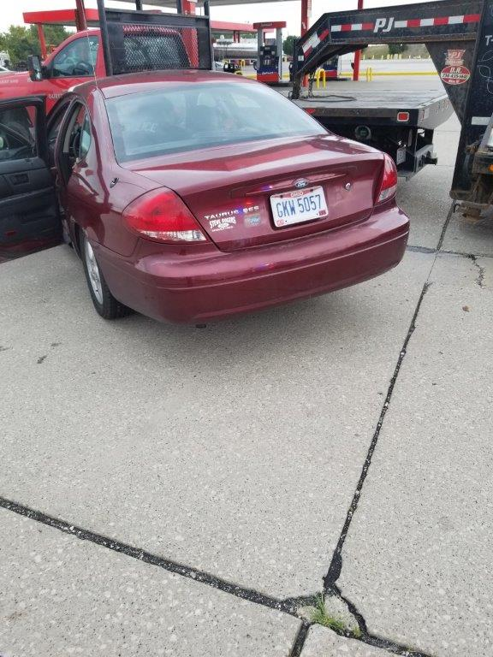
FM 641 Customer to Customer Vehicle Incident:
On 08/12/2019 two vehicles turning into FM 641 had a vehicle collision. The passenger vehicle leaked antifreeze. The fire dept. handled the spill cleanup. The officer reviewed FM video footage and cited the female driver of the passenger car. No damage to Ports Petroleum property.

Slide 17
FM 641 customer to customer vehicle incident:
Video

Slide 18
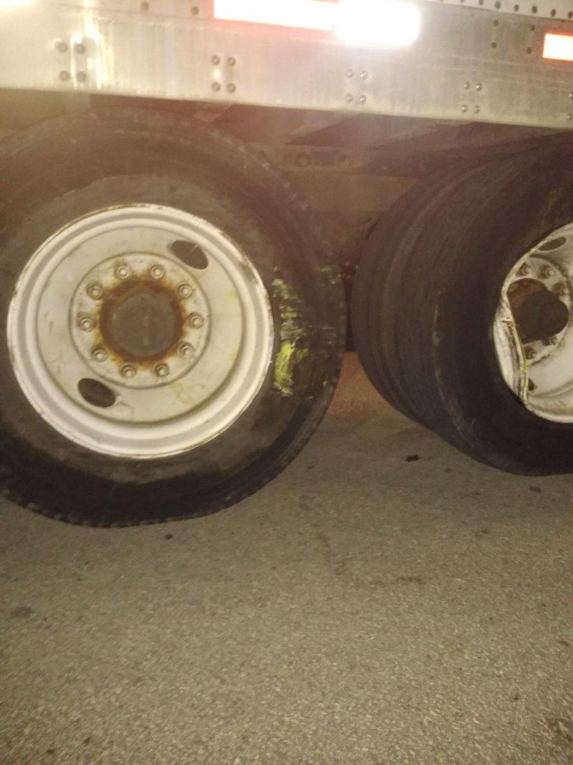
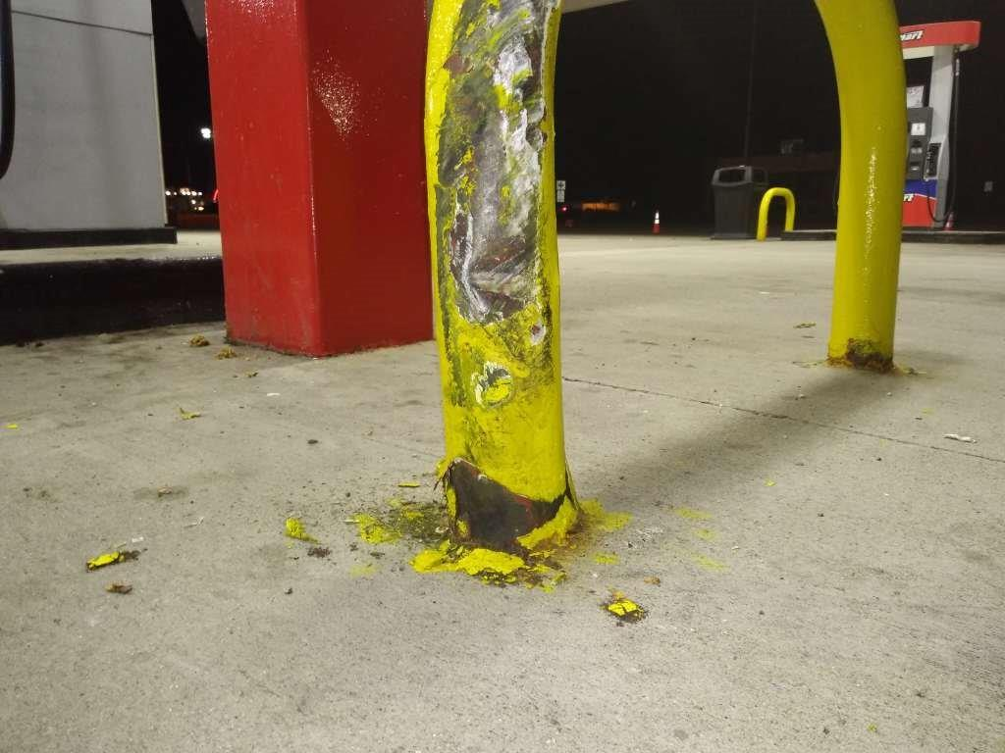
FM 641 property damage:
On 08/13/2019 semi-trailer driver tried to turn around in-between gas pumps 5 & 6 struck the metal U-shaped bollard causing a dent. The driver blew a trailer tire, but left the FM and drove to the TA across the street. Two FM employees went to the TA and got the drivers information. No cracks in the concrete. Paint missing and a dent in the bollard.

Slide 19
FM 767 Customer Incident:
On 08/20/2019 customer passed out from heat exhaustion in front of Subway. Call was placed for police and ambulance. Individual was transported to the hospital.

Slide 20
Date Range: Jan. 01, 2019 – August 20, 2019 Company Total Incidents: 119 FuelMart & Subway Total Incidents: 61 FuelMart & Subway employee injuries Reported: 11 FuelMart Property Damage and/or Vehicle Incidents: 19 FuelMart Customer Spills: 10 (7 at fuel pumps) FuelMart & Subway Customer injuries reported: 17 Other Incidents: 4

Slide 21
Safety Topic School Zone safety

Slide 22
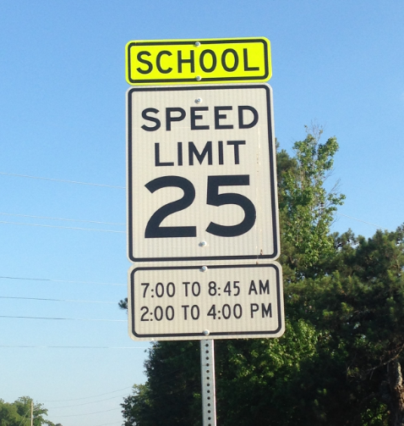
Slow Down: Back to School Means Sharing the Road
School days bring congestion: School buses are picking up their passengers, kids on bikes are hurrying to get to school before the bell rings, hurried parents are trying to drop their kids off before work. It's never more important for drivers to slow down and pay attention than when kids are present – especially before and after school.
Back to school also means enforcement of school zone speed limits!

Slide 23
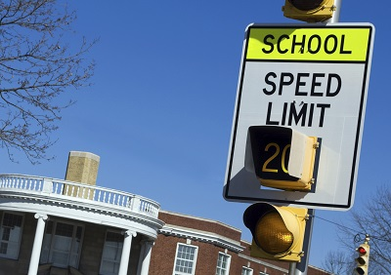
Sharing the Road with Young Pedestrians
According to research by the National Safety Council, most of the children who lose their lives in bus-related incidents are 4 to 7 years old, and they're walking. They are hit by the bus, or by a motorist illegally passing a stopped bus. A few precautions go a long way toward keeping children safe:
Don't block the crosswalk when stopped at a red light or waiting to make a turn, forcing pedestrians to go around you; this could put them in the path of moving traffic
In a school zone when flashers are blinking, stop and yield to pedestrians crossing the crosswalk or intersection
Always stop for a school patrol officer or crossing guard holding up a stop sign
Take extra care to look out for children in school zones, near playgrounds and parks, and in all residential areas
Don't honk or rev your engine to scare a pedestrian, even if you have the right of way
Never pass a vehicle stopped for pedestrians
Always use extreme caution to avoid striking pedestrians wherever they may be, no matter who has the right of way

Slide 24
Sharing the Road with School Busses
If you're driving behind a bus, allow a greater following distance than if you were driving behind a car. It will give you more time to stop once the yellow lights start flashing. It is illegal in all 50 states to pass a school bus that is stopped to load or unload children.
Never pass a bus from behind – or from either direction if you're on an undivided road – if it is stopped to load or unload children
If the yellow or red lights are flashing and the stop arm is extended, traffic must stop
The area 10 feet around a school bus is the most dangerous for children; stop far enough back to allow them space to safely enter and exit the bus
Be alert; children often are unpredictable, and they tend to ignore hazards and take risks

Slide 25
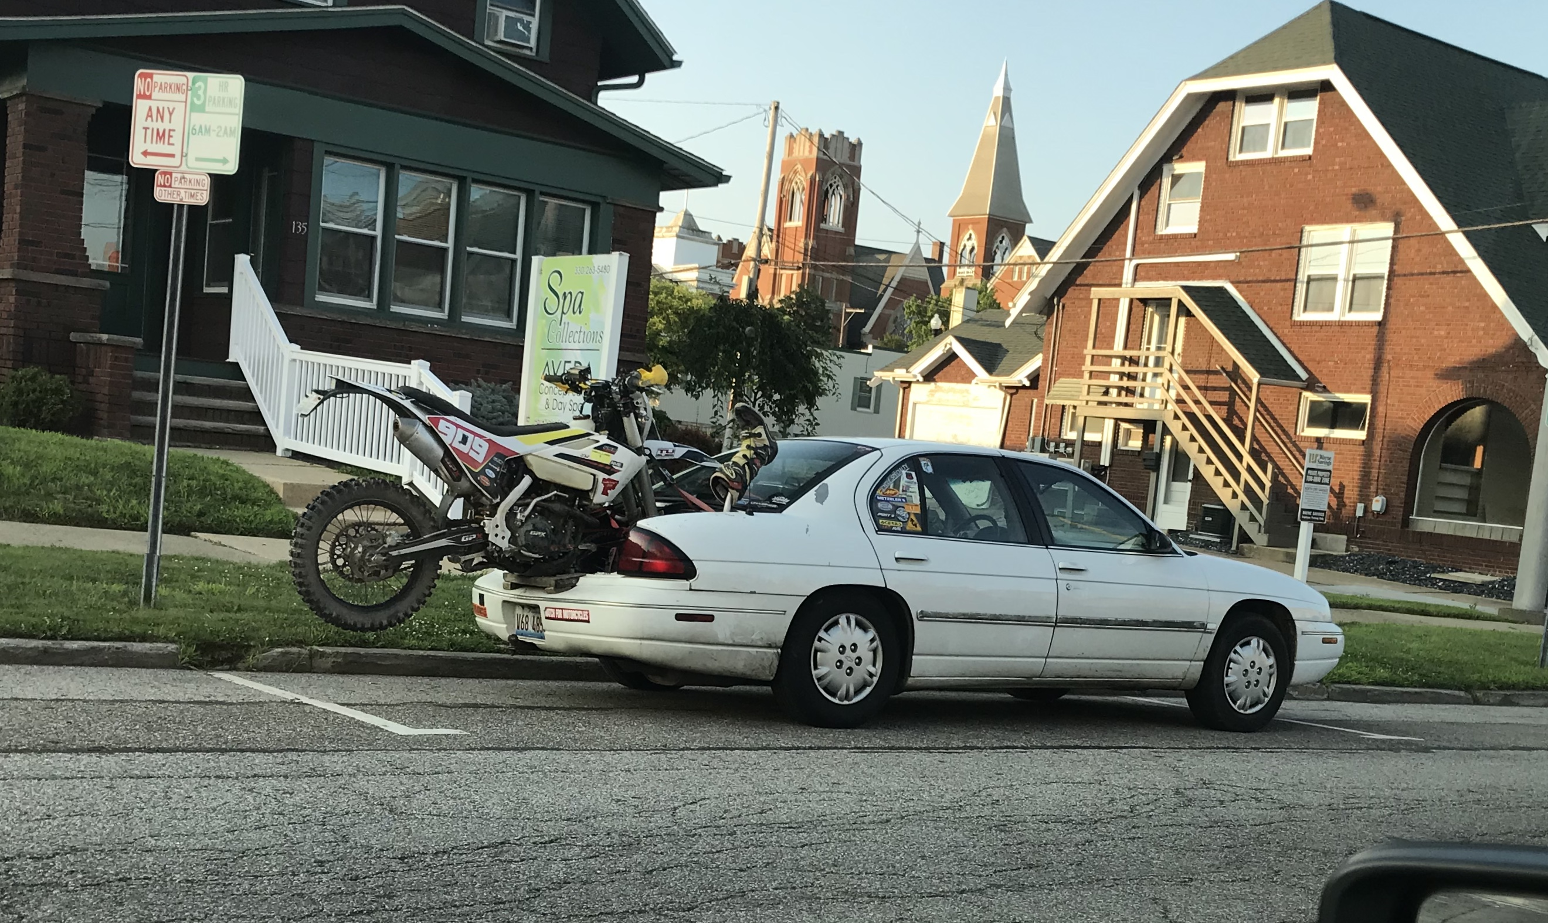
Open Floor Safety Questions / Concerns
Next Safety Committee Meeting is Wednesday, Sept. 18, 2019 at 2:00 PM Eastern

